Slide 1

The ATraTM Black Box System:
Public Health Initiatives
Anne Rhodes, PhD
Director, Health Data Analytics Program
J. C. Smart, Ph.D.
AvesTerra/ATra Chief Scientist
Research Professor, Computer Science
Office of the Senior VP For Research

Slide 2
Objectives
Describe the ATraTM Black Box system
Overview of current ATraTM projects
Future directions for ATraTM work
Contact information

Slide 3

What is ATraTM?
3-Components
Framework
Governance
Physical
Cyber
ATraTM is an architecture where data that cannot be shared can be co-analyzed.
ATraTM is the novel integration of 20+ years of innovations in national security applied to public health.

Slide 4
How does ATraTM work?
The ”black box”
ATra’s core is a computer configured to be highly secure = the black box.
The computer is surrounded by a physical locked-down environment integrated with the black box.
The black box operation is governed by collectively agreed upon processes.
ATra Black Box
Customer Stakeholders
Pre-Authorized
Recipient(s)
Results
Pattern Matches
Questions
Patterns
Analytics
Organization 1
Organization 2
Organization 3
Organization n
Data 1
Data 2
Data 3
Data n

Slide 5
Inputs and Outputs
Inputs
Outputs
Identifiable Data
Integrated datasets
(matched datasets)
ATraTM
Unique identifiers
(codes)
Link Data
(matching algorithm)
integrate/connect/match data based on defined parameters
Analytics and Reporting
Conduct complex processes in a short amount of time
Meta-data
(data about the data)
Personal identifiers
(first/last name, DOB, etc.)
Customizable reporting outputs
(large datasets merged, de-duplication)
Additional Data
Meta data
(data about data)
Customizable analytic outputs
(statistical and analytic tables)
Data associated with identifiable inputs
Notes:
Inputs
Data entered in the platform must have the ability to be linked and may include additional data from integrated datasets
Unique Identifiers (unique codes)
Personal Identifiers (first name, last name, date of birth, etc.)
Meta data (Data about the data)
Additional data (Additional data associated with the unique/personal identifiers)
Atra
Secure data transfer
Integrating/connecting (matching) data based on defined parameters (matching algorithm)
Conducts complex reporting and analytics in a short amount of time
Outputs
Integrated datasets (matched datasets)
Meta-data (data about the process and/or other aspects of the data)
Customizable reporting outputs (e.g., large datasets merged, de-duplication)
Customizable analytic outputs (e.g. statistical and analytic tables)

Slide 6
Data flow
Inputs
Outputs
Data Source 1
ATraTM
(Secure Data Platform)
Integrated Datasets
Data Source 2
Meta-data/Metrics
Data Source 3
Analytics Outputs

Slide 7




Why use ATraTM?
Assist in automating business processes and/or meeting existing needs of data integration
Explore new ways to achieve big data analytic goals
Decrease time (person power) needed in the integration of multiple data sources
Provide a secure mechanism to link PII/PHI across data systems where barriers to doing so may exist

Slide 8
Current ATraTM Projects
18-1805
National HIV Surveillance de-duplication
5J
Enhancements for Sharing HIV Surveillance Data
DC Cohort
Sharing of data from ongoing cohort study with DC Dept of Health data systems
STI
Sharing of Sexually Transmitted Infection surveillance data across 3 jurisdictions

Slide 9
18-1805 Project (5 years): Secure Data Sharing Tool to Support De-duplication of Cases in the National HIV Surveillance System (NHSS)
Supports 18-1802 funded jurisdictions by providing a tool to assist with RIDR/CIDR de-duplication
Provides the ability to rapidly exchange data in a safe and secure manner that meets the highest security and confidentiality guidelines
Improves timeliness, completeness, and accuracy of HIV Surveillance data – used for Continuum of Care and Ending the HIV Epidemic indicators
Notes:
The ability to rapidly exchange data in a safe and secure manner that meets the highest security and confidentiality guidelines will be an important component of new efforts to combat the HIV epidemic
Understanding migration on a regional and national level will assist in streamlining data-to-care efforts by eliminating efforts to assess duplicate data
Rapid response to new infections is enhanced by reporting timely data to the health department
HIV data surveillance is one of the cornerstones to ending the HIV epidemic
Understanding migration on a regional and national level will assist in streamlining data-to-care efforts by eliminating duplicate efforts
Rapid response to new infections is enhanced by reporting timely data to the health department

Slide 10
18-1805 Project: Current Status
35 jurisdictions currently have a signed data sharing agreement and are participating in deduplication activities
Preliminary data show an average of over 50% in the reduction of duplicate case pairs between jurisdictions
Has significantly reduced time jurisdictions spend on manual review of potentially duplicate cases
Notes:
The ability to rapidly exchange data in a safe and secure manner that meets the highest security and confidentiality guidelines will be an important component of new efforts to combat the HIV epidemic
Understanding migration on a regional and national level will assist in streamlining data-to-care efforts by eliminating efforts to assess duplicate data
Rapid response to new infections is enhanced by reporting timely data to the health department
HIV data surveillance is one of the cornerstones to ending the HIV epidemic
Understanding migration on a regional and national level will assist in streamlining data-to-care efforts by eliminating duplicate efforts
Rapid response to new infections is enhanced by reporting timely data to the health department

Slide 11
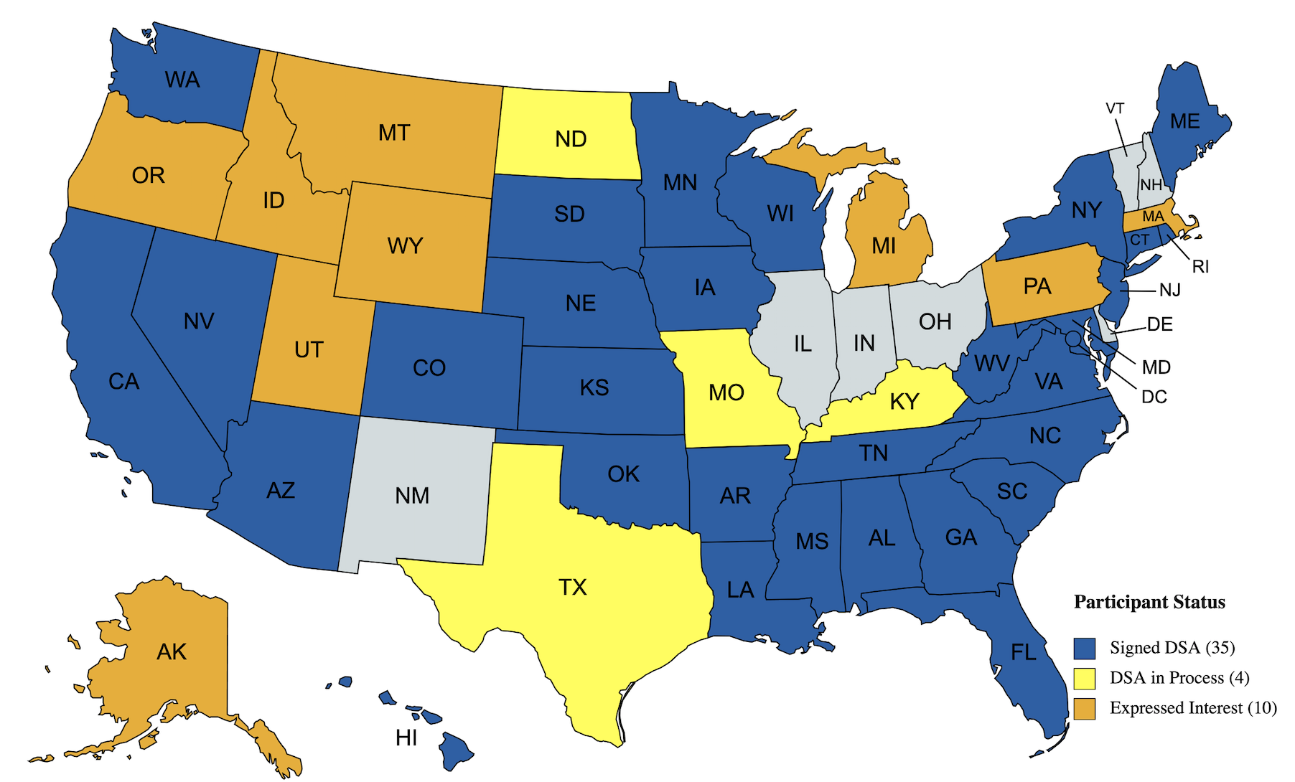
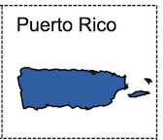
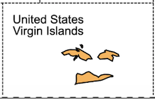
18-1805 Current Participants
August 2021

Slide 12
The 5J Project
DC, LA, MD, VA, NY (including NYC) participating
Each jurisdiction contracts directly with Georgetown to enhance the utility of the Black Box
Two to four runs a year (as needed)

Slide 13
5J Enhancements (Current)
Enhancement | Implementation in the ATra Black Box
Update to matching algorithm based on analysis of matches (dropped race, no match on only SSN, etc.); Added additional data checks for some data variables (e.g. SSN) to improve matching | December 2018
Increase accuracy of each jurisdiction’s current residential addresses in eHARS through exchange of data for match pairs from other jurisdictions | Residential Address Change Enhancement (Dec. 2018)
Provide a feedback loop of previously seen cases from prior Black Box runs or prior RIDR reviews in order to identify only new matches | Duplicate Status Review Enhancement (Dec. 2018)
Increase the number and accuracy of matches by using all Person-View (PV) and non-PV names for a case record | Multiple Names Enhancement (Dec. 2019)
Provide data analytics and output reports related to vital status discrepancies by exchanging death data from three different death document data sources in eHARS | Vital Status Check Enhancement (Sept. 2020)

Slide 14
5J Results: Names Enhancement
Number of matches
Increased by 9,070 matches (4.6%)
Increase in match levels
25,776 matches moved from Low to High levels (13.4%)
Matches Not Seen Before
6,787 matches not seen before (3.5%)

Slide 15
DC Cohort Project
Work with George Washington (GW) University and DC Department of Health
Match data from the DC Cohort study with DC DOH data, including HIV surveillance, STI, TB, and Hepatitis
Allow GW to receive data with no PHI to meet IRB requirements

Slide 16
STI Project
Work with DC, MD, and VA to share STI surveillance and partner services data among jurisdictions
Will replace manual process of Disease Intervention Specialists and other staff calling to obtain data needed for case investigations

Slide 17

A Secure Method for Analysis of Private Information
ATraTM Roadmap Update
J. C. Smart, Ph.D.
AvesTerra/ATra Chief Scientist
Research Professor
Department of Computer Science
Office of the Senior Vice President for Research
smart@georgetown.edu
April 2021

Slide 18
Future ATraTM Functionality
Enhancement | Implementation in the ATraTM Black Box
Templating: Matching with other datasets (including Ryan White, Medicaid, other local data) | October 2021
Analytics: Summaries for geographical areas, including Ryan White Part A and summaries including key HIV outcomes (retention, viral suppression) for specific groups | March 2022
On-Demand Matching: can perform runs at any time and only get new data (such as labs, address, etc) | Summer 2022

Slide 19
Top Goals: ATraTM Version 4 & Version 5
Goal 1 – Ease of Use
  Streamline graphical user interface to improve usability/reduce errors
  Provide ”On Demand” matching and analysis
  Significantly reduce data load time
  Reduce need for opening/closing of the “Black Box”
  Ability for multiple/simultaneous matching/analytic sessions
Goal 2 – Functionality
  Flexible input file formats and fields
  Automated/streamlined data validation
  Ability to process new and changing data sources
  Ability to dynamically add new analytics capabilities and features
  Improved pre- and post-processing service support
  Generalize for applications beyond eHARS/RIDR
Goal 3 – Security
  Further enhanced data protection and security/isolation measures
  Offload non-critical tasks from “Black Box” to client application

Slide 20

ATraTM Platform (V4)
Client Application
Graphic User Interface
Verification
Normalization
“Patterns”
“Templates”
Encrypted Data Transfer
Input/Output
Directories
*.dat, *.atra
ATra
Engine
*.txt, *.log
*.dat, *.atra
*.txt, *.log
…
“Black Box”
…
*.dat, *.atra
*.txt, *.log
Patterns
Data
Reports
Logs
Power
Cooling

Slide 21
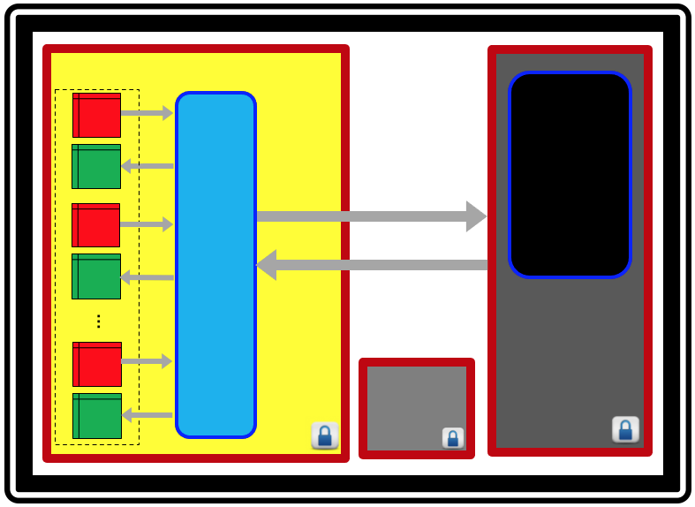
The ATraTM “Client” application
ATra
Client
Internet
Infrastructure
ATra
Client
“Black Box” Enclave
ATra
Client
VPN
Infrastructure
ATra
Client

Slide 22
Top Benefits of Version 4
Benefit 1: Continued security enhancement
Benefit 2: Greater ease-of-use/more streamlined workflow
Benefit 3: Reduced chance of errors
Benefit 4: Ability to more easily add pre- and post-processing functions
Benefit 5: Reduced ”Black Box” complexity (increased reliability)
Benefit 6: Significantly faster data load times
Benefit 7: Reduced of “Black Box” commissioning/decommissioning
Benefit 8: Ability to more easily accommodate new functionality
Benefit 9: Reduced cost/greater-performance
Benefit 10: Ability to continue running at Equinix

Slide 23
ATraTM Platform (V5.0)
Client Application
Graphic User Interface
Verification
Normalization
“Patterns”
“Templates”
Logs & Reports
Encrypted
AvesTerra
Engine
HGTP
HGTP
…
ATra Analytics
HGTP
“Black Box”
Power
Cooling

Slide 24
Top Benefits of Version 5
Benefit 1: Elimination of bulk data movement
Benefit 2: Elimination of data load time
Benefit 3: Ability to more easily validate/verify data prior to analysis
Benefit 4: Ability to more easily accommodate new functionality
Benefit 5: Ability to more easily add pre- and post-processing functions
Benefit 6: “On-Demand” analysis (continuous/real-time results)
Benefit 7: Reduction of “Black Box” commissioning/decommissioning

Slide 25
Contact Information
Anne Rhodes, anne.rhodes@georgetown.edu
J Smart, smart@georgetown.edu

